Slide 1
阿里云基础设施网络
智能运维研究
翟恩南（恩南）
网络研究团队

Slide 2

01
复杂的云网络基础设施规划
02
基于 IBN 思想的网络规划
目录
03
具体例子：网络验证
04
更多的方向和未来的思考

Slide 3



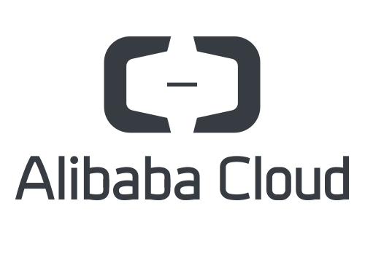
阿里云全球基础设施网络系统
阿里全球 DNS 系统

Slide 4


阿里云全球基础设施网络系统
阿里全球 DNS 系统
全球广域网质量监测流量调度系统

Slide 5
阿里云全球基础设施网络系统
阿里全球 DNS 系统
全球领先的超大规模高性能数据中心
全球广域网质量监测流量调度系统

Slide 6
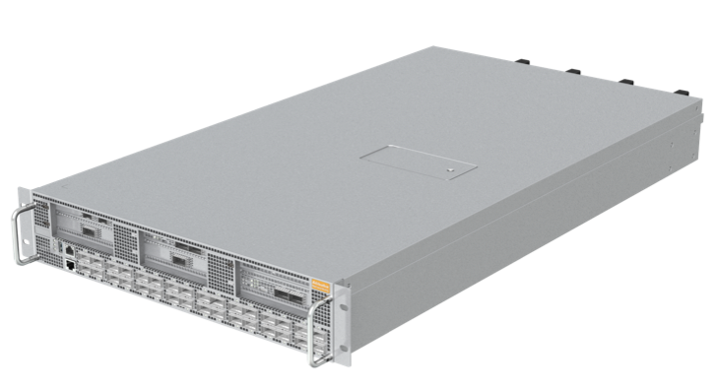
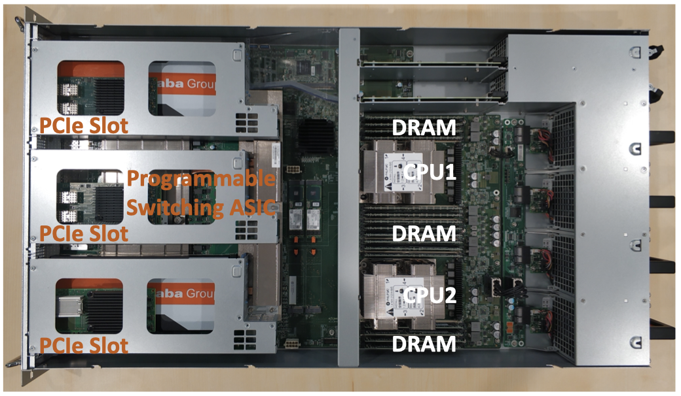
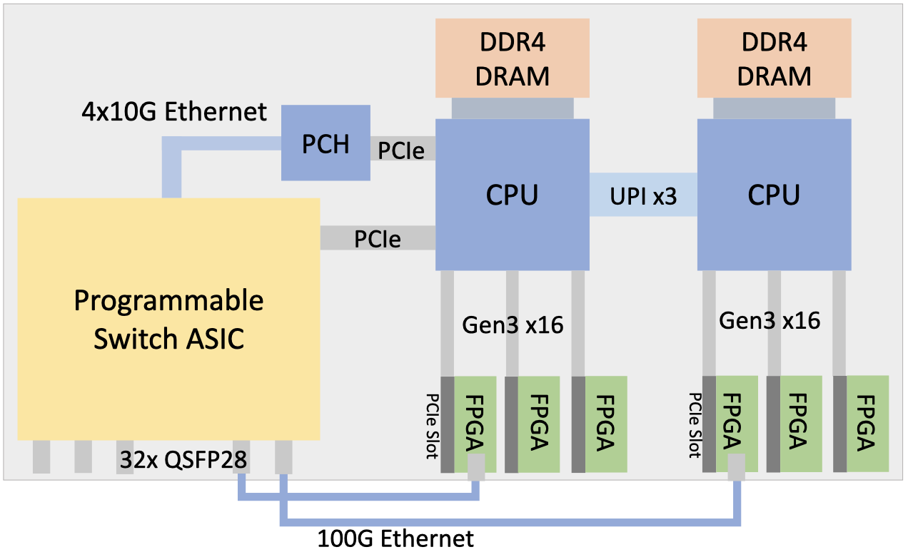
阿里云全球基础设施网络系统
阿里全球 DNS 系统
全球领先的超大规模高性能数据中心
全球广域网质量监测流量调度系统
全球最大规模部署的可编程计算网关系统

Slide 7
阿里云全球基础设施网络系统
阿里全球 DNS 系统
网络的价值和挑战在于 网络规模
全球领先的超大规模高性能数据中心
在网络规模持续增长的情况下，如何保证稳定性和高性能
全球广域网质量监测流量调度系统
规模驱动下带来的挑战
全球最大规模部署的可编程计算网关系统

Slide 8
阿里云全球基础设施网络系统
阿里全球 DNS 系统
全球领先的超大规模高性能数据中心
挑战1：稳定性/可靠性
挑战2：运维效率
全球广域网质量监测流量调度系统
挑战3：可预期流量调度
全球最大规模部署的可编程计算网关系统

Slide 9
阿里云全球基础设施网络系统
阿里全球 DNS 系统
全球领先的超大规模高性能数据中心
挑战1：稳定性/可靠性
仿真验证预防变更风险 [SIGCOMM’20]
网络快速监控与故障定位
挑战2：运维效率
意图驱动体系，将运维决策从人
交到系统 [SIGCOMM’19]
全球广域网质量监测流量调度系统
挑战3：可预期流量调度
细粒度应用感知的流量调度
全球最大规模部署的可编程计算网关系统

Slide 10
阿里云全球基础设施网络系统
阿里全球 DNS 系统
挑战1：弹性可扩展
挑战2：稳定性/可靠性
全球领先的超大规模高性能数据中心
挑战3：高性能算力
挑战1：稳定性/可靠性
仿真验证预防变更风险 [SIGCOMM’20]
网络快速监控与故障定位
挑战2：运维效率
意图驱动体系，将运维决策从人
交到系统 [SIGCOMM’19]
全球广域网质量监测流量调度系统
挑战3：可预期流量调度
细粒度应用感知的流量调度
全球最大规模部署的可编程计算网关系统

Slide 11
阿里云全球基础设施网络系统
阿里全球 DNS 系统
挑战1：弹性可扩展
自研交换机，协议简化，体系化融合
挑战2：稳定性/可靠性
实时遥测精准定位故障 [SIGCOMM’20]
全球领先的超大规模高性能数据中心
挑战3：高性能算力
精确反馈拥塞控制、端网协同低延时 [SIGCOMM’19, 22]
挑战1：稳定性/可靠性
仿真验证预防变更风险 [SIGCOMM’20]
网络快速监控与故障定位
挑战2：运维效率
意图驱动体系，将运维决策从人
交到系统 [SIGCOMM’19]
全球广域网质量监测流量调度系统
挑战3：可预期流量调度
细粒度应用感知的流量调度
全球最大规模部署的可编程计算网关系统

Slide 12
阿里云全球基础设施网络系统
阿里全球 DNS 系统
挑战1：弹性可扩展
自研交换机，协议简化，体系化融合
挑战2：稳定性/可靠性
实时遥测精准定位故障 [SIGCOMM’20]
全球领先的超大规模高性能数据中心
挑战3：高性能算力
精确反馈拥塞控制、端网协同低延时 [SIGCOMM’19, 22]
挑战1：稳定性/可靠性
仿真验证预防变更风险 [SIGCOMM’20]
网络快速监控与故障定位
挑战2：运维效率
意图驱动体系，将运维决策从人
交到系统 [SIGCOMM’19]
全球广域网质量监测流量调度系统
挑战3：可预期流量调度
细粒度应用感知的流量调度
挑战1：芯片编程效率
全球最大规模部署的可编程计算网关系统
挑战2：芯片程序正确性

Slide 13
阿里云全球基础设施网络系统
阿里全球 DNS 系统
挑战1：弹性可扩展
自研交换机，协议简化，体系化融合
挑战2：稳定性/可靠性
实时遥测精准定位故障 [SIGCOMM’20]
全球领先的超大规模高性能数据中心
挑战3：高性能算力
精确反馈拥塞控制、端网协同低延时 [SIGCOMM’19, 22]
挑战1：稳定性/可靠性
仿真验证预防变更风险 [SIGCOMM’20]
网络快速监控与故障定位
挑战2：运维效率
意图驱动体系，将运维决策从人
交到系统 [SIGCOMM’19]
全球广域网质量监测流量调度系统
挑战3：可预期流量调度
细粒度应用感知的流量调度
挑战1：芯片编程效率
Lyra 异构芯片的程序编译 [SIGCOMM’20]
可证明最优的芯片资源自动优化 [NSDI’22]
全球最大规模部署的可编程计算网关系统
挑战2：芯片程序正确性
全逻辑覆盖的自动化测试生成 [SIGCOMM’22]

Slide 14


网络规划和运维的复杂
变更
设计
交付
现网运维
复杂
复杂
异构
异构
规模大
繁多的路由协议
路由重策略繁多
细节参数繁多
厂商差异性
变更频
规模大
变更频
大量设备分布协同
万行配置/设备
万次变更每年
需求多样化
靠人的 “小心谨慎” 是
无法避免的
Notes:
To prevent the incidents resulting from network misconfiguration, Alibaba decided to adopt network verification to prevent configuration-induced incidents ahead of time. Our verification system is named Hoyan Jinjing. This name is from the skill of the monkey king in ancient Chinese myths, which means the monkey king can see the truth through his fire and golden eye. In SIGCOMM last year, we have presented our ACL verification work, Jinjing. Today I am going to talk about Hoyan, the routing configuration verification system.

Slide 15


DSW1
DSW2
10/8
10/8
PSW
Notes:
To prevent the incidents resulting from network misconfiguration, Alibaba decided to adopt network verification to prevent configuration-induced incidents ahead of time. Our verification system is named Hoyan Jinjing. This name is from the skill of the monkey king in ancient Chinese myths, which means the monkey king can see the truth through his fire and golden eye. In SIGCOMM last year, we have presented our ACL verification work, Jinjing. Today I am going to talk about Hoyan, the routing configuration verification system.

Slide 16
DSW1
DSW2
意图：
DSW3 替换 DSW2
10/8
10/8
PSW
Notes:
To prevent the incidents resulting from network misconfiguration, Alibaba decided to adopt network verification to prevent configuration-induced incidents ahead of time. Our verification system is named Hoyan Jinjing. This name is from the skill of the monkey king in ancient Chinese myths, which means the monkey king can see the truth through his fire and golden eye. In SIGCOMM last year, we have presented our ACL verification work, Jinjing. Today I am going to talk about Hoyan, the routing configuration verification system.

Slide 17
拷贝配置+改参数
DSW1
DSW2
DSW1
DSW2
DSW3
意图：
DSW3 替换 DSW2
10/8
10/8
10/8
10/8
10/8
PSW
PSW
Notes:
To prevent the incidents resulting from network misconfiguration, Alibaba decided to adopt network verification to prevent configuration-induced incidents ahead of time. Our verification system is named Hoyan Jinjing. This name is from the skill of the monkey king in ancient Chinese myths, which means the monkey king can see the truth through his fire and golden eye. In SIGCOMM last year, we have presented our ACL verification work, Jinjing. Today I am going to talk about Hoyan, the routing configuration verification system.

Slide 18
拷贝配置+改参数
DSW1
DSW2
DSW1
DSW2
DSW3
DSW1
DSW3
意图：
DSW3 替换 DSW2
10/8
10/8
10/8
10/8
10/8
10/8
10/8
PSW
PSW
PSW
Notes:
To prevent the incidents resulting from network misconfiguration, Alibaba decided to adopt network verification to prevent configuration-induced incidents ahead of time. Our verification system is named Hoyan Jinjing. This name is from the skill of the monkey king in ancient Chinese myths, which means the monkey king can see the truth through his fire and golden eye. In SIGCOMM last year, we have presented our ACL verification work, Jinjing. Today I am going to talk about Hoyan, the routing configuration verification system.

Slide 19
拷贝配置+改参数
DSW1
DSW2
DSW1
DSW2
DSW3
DSW1
DSW3
意图：
DSW3 替换 DSW2
10/8
10/8
10/8
10/8
10/8
10/8
10/8
我们认为
PSW
PSW
PSW
实际情况
Notes:
To prevent the incidents resulting from network misconfiguration, Alibaba decided to adopt network verification to prevent configuration-induced incidents ahead of time. Our verification system is named Hoyan Jinjing. This name is from the skill of the monkey king in ancient Chinese myths, which means the monkey king can see the truth through his fire and golden eye. In SIGCOMM last year, we have presented our ACL verification work, Jinjing. Today I am going to talk about Hoyan, the routing configuration verification system.

Slide 20
拷贝配置+改参数
DSW1
DSW2
DSW1
DSW2
DSW3
DSW1
DSW3
意图：
DSW3 替换 DSW2
10/8
10/8
10/8
10/8
10/8
10/8
10/8
我们认为
PSW
PSW
PSW
实际情况
DSW1
DSW2
10/8
PSW
Notes:
To prevent the incidents resulting from network misconfiguration, Alibaba decided to adopt network verification to prevent configuration-induced incidents ahead of time. Our verification system is named Hoyan Jinjing. This name is from the skill of the monkey king in ancient Chinese myths, which means the monkey king can see the truth through his fire and golden eye. In SIGCOMM last year, we have presented our ACL verification work, Jinjing. Today I am going to talk about Hoyan, the routing configuration verification system.

Slide 21
拷贝配置+改参数
DSW1
DSW2
DSW1
DSW2
DSW3
DSW1
DSW3
意图：
DSW3 替换 DSW2
10/8
10/8
10/8
10/8
10/8
10/8
10/8
我们认为
PSW
PSW
PSW
实际情况
拷贝配置+改参数
DSW1
DSW2
DSW1
DSW2
DSW3
10/8
10/8
PSW
PSW
Notes:
To prevent the incidents resulting from network misconfiguration, Alibaba decided to adopt network verification to prevent configuration-induced incidents ahead of time. Our verification system is named Hoyan Jinjing. This name is from the skill of the monkey king in ancient Chinese myths, which means the monkey king can see the truth through his fire and golden eye. In SIGCOMM last year, we have presented our ACL verification work, Jinjing. Today I am going to talk about Hoyan, the routing configuration verification system.

Slide 22
拷贝配置+改参数
DSW1
DSW2
DSW1
DSW2
DSW3
DSW1
DSW3
意图：
DSW3 替换 DSW2
10/8
10/8
10/8
10/8
10/8
10/8
10/8
我们认为
PSW
PSW
PSW
实际情况
拷贝配置+改参数
DSW1
DSW2
DSW1
DSW2
DSW3
DSW1
DSW3
10/8
10/8
PSW
PSW
PSW
Notes:
To prevent the incidents resulting from network misconfiguration, Alibaba decided to adopt network verification to prevent configuration-induced incidents ahead of time. Our verification system is named Hoyan Jinjing. This name is from the skill of the monkey king in ancient Chinese myths, which means the monkey king can see the truth through his fire and golden eye. In SIGCOMM last year, we have presented our ACL verification work, Jinjing. Today I am going to talk about Hoyan, the routing configuration verification system.

Slide 23
01
复杂的云网络基础设施规划
02
基于 IBN 思想的网络规划
目录
03
具体例子：网络验证
04
更多的方向和未来的思考

Slide 24





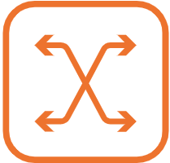
传统基于配置的思想
设计
交付
变更
运维
现网配置 -> Intent
现网配置 -> Intent
现网配置 -> Intent
现网配置 -> Intent
Intent -> 现网配置
Intent -> 现网配置
Intent -> 现网配置
Intent -> 现网配置
不同厂商的设备
Notes:
To prevent the incidents resulting from network misconfiguration, Alibaba decided to adopt network verification to prevent configuration-induced incidents ahead of time. Our verification system is named Hoyan Jinjing. This name is from the skill of the monkey king in ancient Chinese myths, which means the monkey king can see the truth through his fire and golden eye. In SIGCOMM last year, we have presented our ACL verification work, Jinjing. Today I am going to talk about Hoyan, the routing configuration verification system.

Slide 25
IBN 思想：高级抽象
设计
交付
变更
运维
集中式程序
验证：
确保配置在任何情况下满足预期
配置生成：
确保配置由
高维程序生成
不同厂商的设备
Notes:
To prevent the incidents resulting from network misconfiguration, Alibaba decided to adopt network verification to prevent configuration-induced incidents ahead of time. Our verification system is named Hoyan Jinjing. This name is from the skill of the monkey king in ancient Chinese myths, which means the monkey king can see the truth through his fire and golden eye. In SIGCOMM last year, we have presented our ACL verification work, Jinjing. Today I am going to talk about Hoyan, the routing configuration verification system.

Slide 26

IBN 思想
Notes:
To prevent the failures resulting from network misconfiguration, Alibaba decided to adopt network verification to prevent the misconfiguration ahead of time. Our verification system is named Hoyan Jinjing. This name is from the skill of the monkey king in ancient Chinese myths, which means the monkey king can see the truth through his fire and golden eye. This project published two SIGCOMM papers. Today I will focus on Hoyan, a routing configuration verification

Slide 27
集中式网络规划体系
设计
交付
变更
运维
运维描述程序/脚本
核心算法（例如，验证或生成算法）
网络模型（网络行为抽象）
配置解析（屏蔽厂商细节）
不同厂商的设备
Notes:
To prevent the incidents resulting from network misconfiguration, Alibaba decided to adopt network verification to prevent configuration-induced incidents ahead of time. Our verification system is named Hoyan Jinjing. This name is from the skill of the monkey king in ancient Chinese myths, which means the monkey king can see the truth through his fire and golden eye. In SIGCOMM last year, we have presented our ACL verification work, Jinjing. Today I am going to talk about Hoyan, the routing configuration verification system.

Slide 28
核心技术之一：验证
形式化验证
Intent
变更灰度校验
网络变更
变更仿真测试
变更过程实时校验
变更实时验证
实现
核心网检查
形式化验证
网络运维
挑战1：有多准？
挑战2：有多快？
IDC 审计
配置审计
Notes:
To prevent the incidents resulting from network misconfiguration, Alibaba decided to adopt network verification to prevent configuration-induced incidents ahead of time. Our verification system is named Hoyan Jinjing. This name is from the skill of the monkey king in ancient Chinese myths, which means the monkey king can see the truth through his fire and golden eye. In SIGCOMM last year, we have presented our ACL verification work, Jinjing. Today I am going to talk about Hoyan, the routing configuration verification system.

Slide 29
01
复杂的云网络基础设施规划
02
基于 IBN 思想的网络规划
目录
03
具体例子：网络验证
04
更多的方向和未来的思考

Slide 30

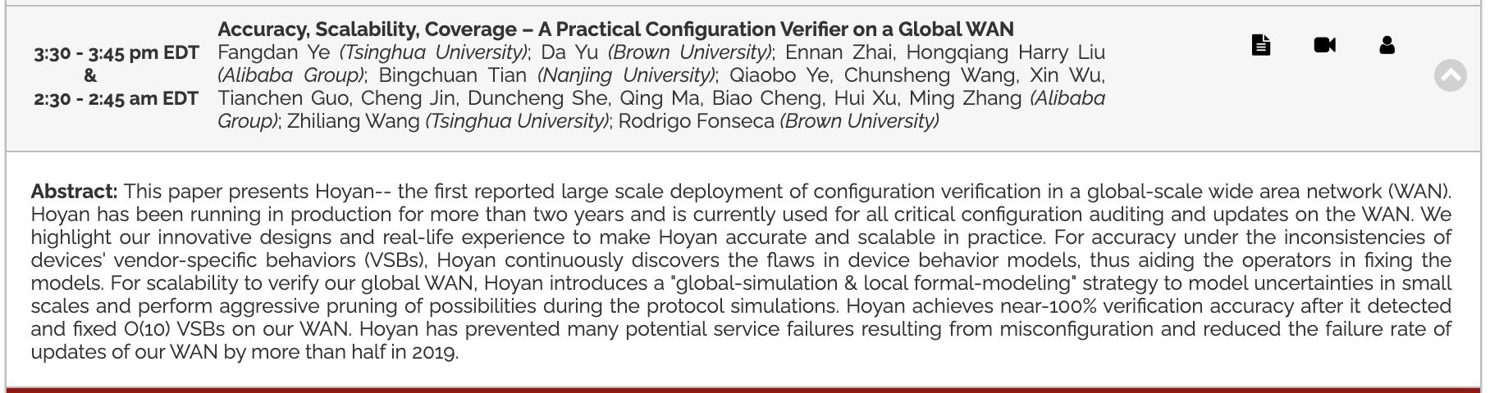
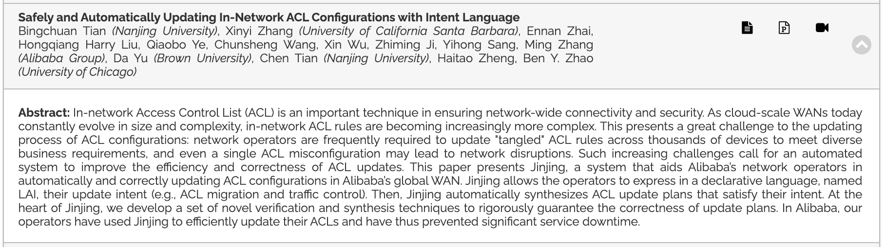

Network configuration verification in Alibaba
Monkey King: Fire & Golden Eye
(The ability to see the truth)
火眼 金睛
Hoyan (火眼)
Routing configuration verification
[ACM SIGCOMM’20]
Jinjing (金睛)
In-Network ACL verification
[ACM SIGCOMM’19]
Notes:
To prevent the incidents resulting from network misconfiguration, Alibaba decided to adopt network verification to prevent configuration-induced incidents ahead of time. Our verification system is named Hoyan Jinjing. This name is from the skill of the monkey king in ancient Chinese myths, which means the monkey king can see the truth through his fire and golden eye. In SIGCOMM last year, we have presented our ACL verification work, Jinjing. Today I am going to talk about Hoyan, the routing configuration verification system.

Slide 31
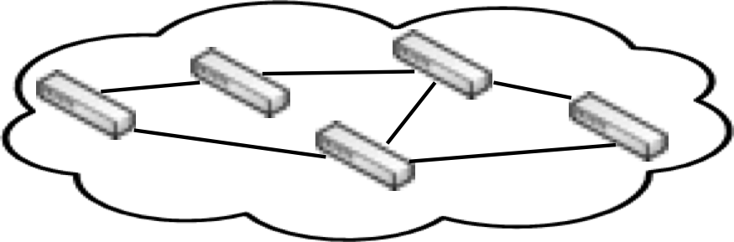
Hoyan
Hoyan
Online Configurations
WAN
Behavior Models
Verification Query
Verification
Target Network Model
Result
Operator
Notes:
Hoyan is built to offer configuration verification to our WAN, and addresses the above two challenges. To use Hoyan system, the operator sends a verification query to the system. Then, Hoyan generates a network behavior model. With this network model, Hoyan reasons about whether the network model meets the input property.

Slide 32
Technical challenges
Challenge 1: Scalability with failure coverage in our global WAN
Notes:
Building Hoyan system requires us to address two technical challenges. The first challenge is how to reason about the properties of our global WAN in a scalable way, especially when considering failure case. We call the reachability under failure case as k-failure property, which means whether the reachability holds if arbitrary k links or nodes fail.

Slide 33


Technical challenges
Challenge 1: Scalability with failure coverage in our global WAN
E
k=1
D
N
M
k=2
F
A
B
C
X
Y
Z
T
Notes:
In the first example, k should be 1, because if the link between D and E fails, the original reachability no longer holds. In the second example, k is 2, because if these two links fail, the reachability is violated.

Slide 34
Technical challenges
Challenge 1: Scalability with failure coverage in our global WAN
Challenge 1: Scalability with failure coverage in our global WAN
Simulation-based verification efforts, e.g., Batfish, need to enumerate $C_{n}^{k}$ cases for checking under arbitrary k failures out of n links
Formal model approaches, e.g., Minesweeper, are not scalable since a large WAN generates a huge SMT formula
Asymmetry of our WAN invalidates symmetry-based simplification approaches
E
k=1
k=2
D
N
M
F
A
B
C
X
Y
Z
T
Notes:
However, reasoning about the k-failure property in our WAN is hard. First, existing simulation-based verification approaches like Batfish need to enumerate all possible cases which has exponential complexity. Second, the state-of-the-art formal model verifications like Minesweeper generate a huge SMT formula for a large scale network. Solving such a huge formula is time-consuming. Finally, because our WAN is not symmetrical, the existing reduction and simplification approaches like Bonsai do not help neither.

Slide 35

Technical challenges
Challenge 2: Faithfulness of device behavior model
router r1
as 100
nw 10/8
nw 20/8
peer r2
r1 to r2 egress
policy r1 to r2:
if any:
add community 920
router r2
as 200
peer r1
peer r3
router r3
as 300
peer r2
r2 to r3 ingress
peer r4
policy r2 to r3:
if prefix == 20/8:
add community 920
router r4
as 400
peer r3
r3 to r4 ingress
policy r3 to r4:
if community != 920:
deny
if prefix == 20/8:
add community 920
if community != 920:
deny
if any:
add community 920
R1 to R2 BGP updates:
10/8, as=100, next=R1, cmty=920
20/8, as=100, next=R1, cmty=920
R2 to R3 BGP updates:
10/8, as=100-200, next=R2, cmty=920
20/8, as=100-200, next=R2, cmty=920
R2 to R3 BGP updates:
10/8, as=100-200-300, next=R3, cmty=920
20/8, as=100-200-300, next=R3, cmty=920
BGP updates
10/8, 20/8
R1
(Vendor A)
R2
(Vendor B)
R3
(Vendor A)
Prefix | AS Path
10/8 | 300, 200, 100
20/8 | 300, 200, 100
R4
(Vendor A)
Notes:
The second challenge is the network model may not accurately represent the real network behaviors due to vendor-specific behaviors. Let me show you a real example for vendor specific behavior. In this example, we have four routers. Router 1, 3 and 4 are provided by Vendor A and Router 2 is from Vendor B. Suppose two prefixes 10/8 and 20/8 arrive. R1 adds the community to them and sends them to R2. R2 keeps the community, then comes R3. R3 tries to add community to prefix 20/8 but finds it already exist. Finally, R4 accepts both of the prefixes and generates the routing table.

Slide 36

Technical challenges
Challenge 2: Faithfulness of device behavior model
router r1
as 100
nw 10/8
nw 20/8
peer r2
r1 to r2 egress
policy r1 to r2:
if any:
add community 920
router r2
as 200
peer r1
peer r3
router r3
as 300
peer r2
r2 to r3 ingress
peer r4
policy r2 to r3:
if prefix == 20/8:
add community 920
router r4
as 400
peer r3
r3 to r4 ingress
policy r3 to r4:
if community != 920:
deny
VSB: remove community
if prefix == 20/8:
add community 920
if community != 920:
deny
if any:
add community 920
R1 to R2 BGP updates:
10/8, as=100, next=R1, cmty=920
20/8, as=100, next=R1, cmty=920
R2 to R3 BGP updates:
10/8, as=100-200, next=R2, cmty=920
20/8, as=100-200, next=R2, cmty=920
R2 to R3 BGP updates:
10/8, as=100-200-300, next=R3, cmty= _ g
20/8, as=100-200-300, next=R3, cmty=920
BGP updates
10/8, 20/8
Prefix | AS Path
10/8 | 300, 200, 100
20/8 | 300, 200, 100
R1
(Vendor A)
R2
(Vendor B)
R3
(Vendor A)
Prefix | AS Path
20/8 | 300, 200, 100
… … | … …
R4
(Vendor A)
Notes:
Unbeknowst to us, R2 in reality is from different vendor from R1, R3 and R4. It has a latent vendor-specific behavior, which removes community of BGP updates. In this case, two prefixes arrive. R1 adds the community to them and sends them to R2. R2 drops the community, then comes R3. R3 adds community only to prefix 20/8. Finally, R4 only accepts prefix 20/8 . We eventually get a different routing table in reality which is different from our simulation result.

Slide 37
Technical challenges
Challenge 2: Faithfulness of device behavior model
Vendors implemented the same protocols in various ways due to the ambiguity of RFC
Vendor-specific behaviors (VSBs) significantly affect the accuracy of network modeling
No existing efforts can detect or tune the VSBs in network model
Challenge 2: Faithfulness of device behavior model
Notes:
So, vendor-specific behaviors can significantly affect the accuracy of our network model, thus making our verification results inaccurate. Vendor-specific behaviors exist because of the ambiguity of RFC. No existing verification system can detect the vendor specific behaviors.

Slide 38
Hoyan
Hoyan
Online Configurations
WAN
Behavior Models
Verification Query
Verification
Target Network Model
Result
Operator
Notes:
Hoyan is built to offer configuration verification to our WAN, and addresses the above two challenges. To use Hoyan system, the operator sends a verification query to the system. Then, Hoyan generates a network behavior model. With this network model, Hoyan reasons about whether the network model meets the input property.

Slide 39
Hoyan
Hoyan
Online Configurations
WAN
Behavior Models
Scalable Verifier
Verification Query
Verification
Target Network Model
Result
Operator
Innovation 1: Scalable Verifier
A set of scalable algorithms to reason about properties of interest
Notes:
The blue part is called configuration verifier, which focuses on reasoning about the configuration correctness in a scalable way. This is our first innovation design to address the first challenge.

Slide 40
Hoyan
Hoyan
Online Configurations
Behavior Model Validator
WAN
Patch
Behavior Models
Scalable Verifier
Verification Query
Verification
Target Network Model
Result
Operator
Innovation 1: Scalable Verifier
A set of scalable algorithms to reason about properties of interest
Notes:
In order to ensure the correctness of network behavior model, we also equip Hoyan with behavior model valuator to tune the network model in a periodic way.

Slide 41
Hoyan
Innovation 2: Model Tuner
A systematic way to tune the accuracy of network model
Hoyan
Online Configurations
Behavior Model Validator
WAN
Patch
Model Tuner
Behavior Models
Scalable Verifier
Verification Query
Verification
Target Network Model
Result
Operator
Innovation 1: Scalable Verifier
A set of scalable algorithms to reason about properties of interest
Notes:
The gray part is called model tuner, which is responsible for ensuring the accuracy of generated behavior model. It addresses our second challenge. Now let me show you how did we address the two challenges.

Slide 42

Hoyan
Innovation 2: Model Tuner
A systematic way to tune the accuracy of network model
Hoyan
Online Configurations
Behavior Model Validator
WAN
Patch
Model Tuner
Behavior Models
Scalable Verifier
Verification Query
Verification
Target Network Model
Result
Operator
Innovation 1: Scalable Verifier
A set of scalable algorithms to reason about properties of interest
Notes:
Let me first show you how do we address the scalability challenge

Slide 43
How to address the scalability challenge?
Key insight:
Simulation-based approaches are scalable but fail to cover all possible cases
Formal model approaches can encode all possibilities and conditions as a formula but are not scalable because solving such a huge formula is expensive
Notes:
To address the scalability challenge, our insight includes the following. Simulation-based approaches like Batfish are scalable in large network but are slow in handling preferred properties such as k-failure tolerance verification; on the other hand, formal model approaches like Minesweeper can reason about any property well but are not scalable to large networks.

Slide 44
How to address the scalability challenge?
Key insight:
Simulation-based approaches are scalable but fail to cover all possible cases
Formal model approaches can encode all possibilities and conditions as a formula but are not scalable because solving such a huge formula is expensive
Solution: Global simulation & locally formal modeling approach
We run overall simulation for global scalability
Each router node locally encodes its all possible routing conditions that are transmitted along with the simulation process
Notes:
So, we propose a combination solution named global simulation and locally formal modeling. Our approach runs overall simulation for global scalability. At the same time, each router node in our network model locally encodes its all possible routing conditions that are transmitted along with the simulation process.

Slide 45
Global simulation & local formal-modeling
Checking k-failure tolerance between A and D
A
(AS 100)
C
(AS 300)
D
(AS 400)
a1
a4
a2
a3
B
(AS 200)
Notes:
The key design for scalability is a global simulation and local formal modeling approach to reason about the reachability. Let me show you one simple example. In this example, we have four routers, A, B, C and D. Each of them belongs to different AS domain. Every link has unique ID.

Slide 46
Global simulation & local formal-modeling
Checking k-failure tolerance between A and D
A
(AS 100)
C
(AS 300)
D
(AS 400)
10/8
a1
a4
BGP
Announcement
a2
a3
B
(AS 200)
Notes:
Router A is a BGP announcement node which announces a prefix 10/8. In this example, we aim to reason about k-failure reachability where k is equal to 1, which means whether the reachability of this network can tolerate arbitrary one link fault.

Slide 47
Global simulation & local formal-modeling
Checking k-failure tolerance between A and D
AS=100, next=A, a1
A
(AS 100)
C
(AS 300)
D
(AS 400)
10/8
a1
a4
BGP
Announcement
AS=100, next=A, a2
C’s RIB encoding:
r1=(100, A, a1)
r2=(100-200, B, a2∧a3)
a2
a3
B
(AS 200)

Slide 48
Global simulation & local formal-modeling
Checking k-failure tolerance between A and D
A
(AS 100)
C
(AS 300)
D
(AS 400)
10/8
a1
a4
BGP
Announcement
C’s RIB encoding:
r1=(100, A, a1)
r2=(100-200, B, a2∧a3)
C’s RIB encoding:
r1=(100, A, a1)
r2=(100-200, B, a2∧a3)
AS=100, next=A, a2
C’s RIB encoding:
r1=(100, A, a1)
r2=(100-200, B, a2∧a3)
a2
a3
B
(AS 200)
AS=100-200, next=B, a2∧a3

Slide 49
Global simulation & local formal-modeling
AS=100-300, next=C, a1
Checking k-failure tolerance between A and D
AS=100-200-300, next=C,
¬a1 ∧ a2 ∧ a3
A
(AS 100)
C
(AS 300)
D
(AS 400)
10/8
a1
a4
BGP
Announcement
Route Selection
C’s RIB encoding:
r1=(100, A, a1)
r2=(100-200, B, a2∧a3)
a2
a3
B
(AS 200)
Best
Second

Slide 50
Global simulation & local formal-modeling
AS=100-300, next=C, a1
Checking k-failure tolerance between A and D
AS=100-200-300, next=C,
¬a1 ∧ a2 ∧ a3
A
(AS 100)
C
(AS 300)
D
(AS 400)
10/8
a1
a4
BGP
Announcement
D’s RIB encoding:
r3=(100, C, a1∧a4)
r4=(100-200-300, B, ¬a1∧a2∧a3∧a4)
D’s RIB encoding:
r3=(100, C, a1∧a4)
r4=(100-200-300, C, ¬a1∧a2∧a3∧a4)
a2
a3
B
(AS 200)

Slide 51
Global simulation & local formal-modeling
Checking k-failure tolerance between A and D
A
(AS 100)
C
(AS 300)
D
(AS 400)
10/8
a1
a4
BGP
Announcement
D’s RIB encoding:
r3=(100, C, a1∧a4)
r4=(100-200-300, C, ¬a1∧a2∧a3∧a4)
a2
a3
B
(AS 200)
The local formula of “route of A reach D” is (a1 ∧ a4) ∨ (¬a1 ∧ a2 ∧ a3 ∧ a4)
¬a4
Notes:
By far, we have finished the entire verification process. We can use SMT solver to get the result that k is equal to 1 in this network, because if a4 is down, the reachability does not hold between A and D.

Slide 52
Global simulation & local formal-modeling
Checking k-failure tolerance between A and D
A
(AS 100)
C
(AS 300)
D
(AS 400)
10/8
a1
a4
BGP
Announcement
D’s RIB encoding:
r3=(100, C, a1∧a4)
r4=(100-200-300, C, ¬a1∧a2∧a3∧a4)
a2
a3
B
(AS 200)
The good scalability comes from:
Dropping more than k cases
Dropping impossible cases
Simplifying logical formulas
Notes:
To make the algorithm scalable enough, we optimize this algorithm by the following ways like dropping more than k cases, dropping impossible cases and simplifying logical formulas during the simulation process. In addition, Hoyan can run the above simulation for different prefixes in a parallel way.

Slide 53
Comparing Hoyan, Batfish and Minesweeper
A sub-network: 80 routers with thousands of lines of configurations
Network Properties |  | Hoyan | Minesweeper | Batfish
Reachability | k=0 | 14 seconds | 84,043 seconds | 683 seconds
 | k=1 | 22 seconds | > 24 hours | > 24 hours
 | k=2 | 43 seconds | > 24 hours | > 24 hours
 | k=3 | 1176 seconds | > 24 hours | > 24 hours
Role Equivalence |  | 4 seconds | > 24 hours | -
Notes:
We chose some subnetworks in our WAN to compare Hoyan with the state of the art. For instance, this table shows the comparison result of Hoyan, Batfish and Minesweeper on a medium-size subnetwork with 80 routers. We failed to get results from Batfish or Minesweeper when we tried to reason about the k-failure tolerance property, but Hoyan returned results in reasonable time.

Slide 54
Hoyan
Innovation 2: Model Tuner
A systematic way to tune the accuracy of network model
Hoyan
Online Configurations
Behavior Model Validator
WAN
Patch
Model Tuner
Behavior Models
Scalable Verifier
Verification Query
Verification
Target Network Model
Result
Operator
Innovation 1: Scalable Verifier
A set of scalable algorithms to reason about properties of interest
Notes:
Now let me show you how do we address the model accuracy challenge

Slide 55
How to address the model faithfulness challenge?
Key insight:
Using production network RIBs as a reference to debug simulated model
Notes:
In order address the second challenge, we build a device behavior model tuner which uses production network as a reference for our simulated model debugging. Specifically, the model tuner periodically collects real-world routing tables and checks the difference between the real-world routing tables and simulated routing tables in order to localize the vendor specific behaviors.

Slide 56
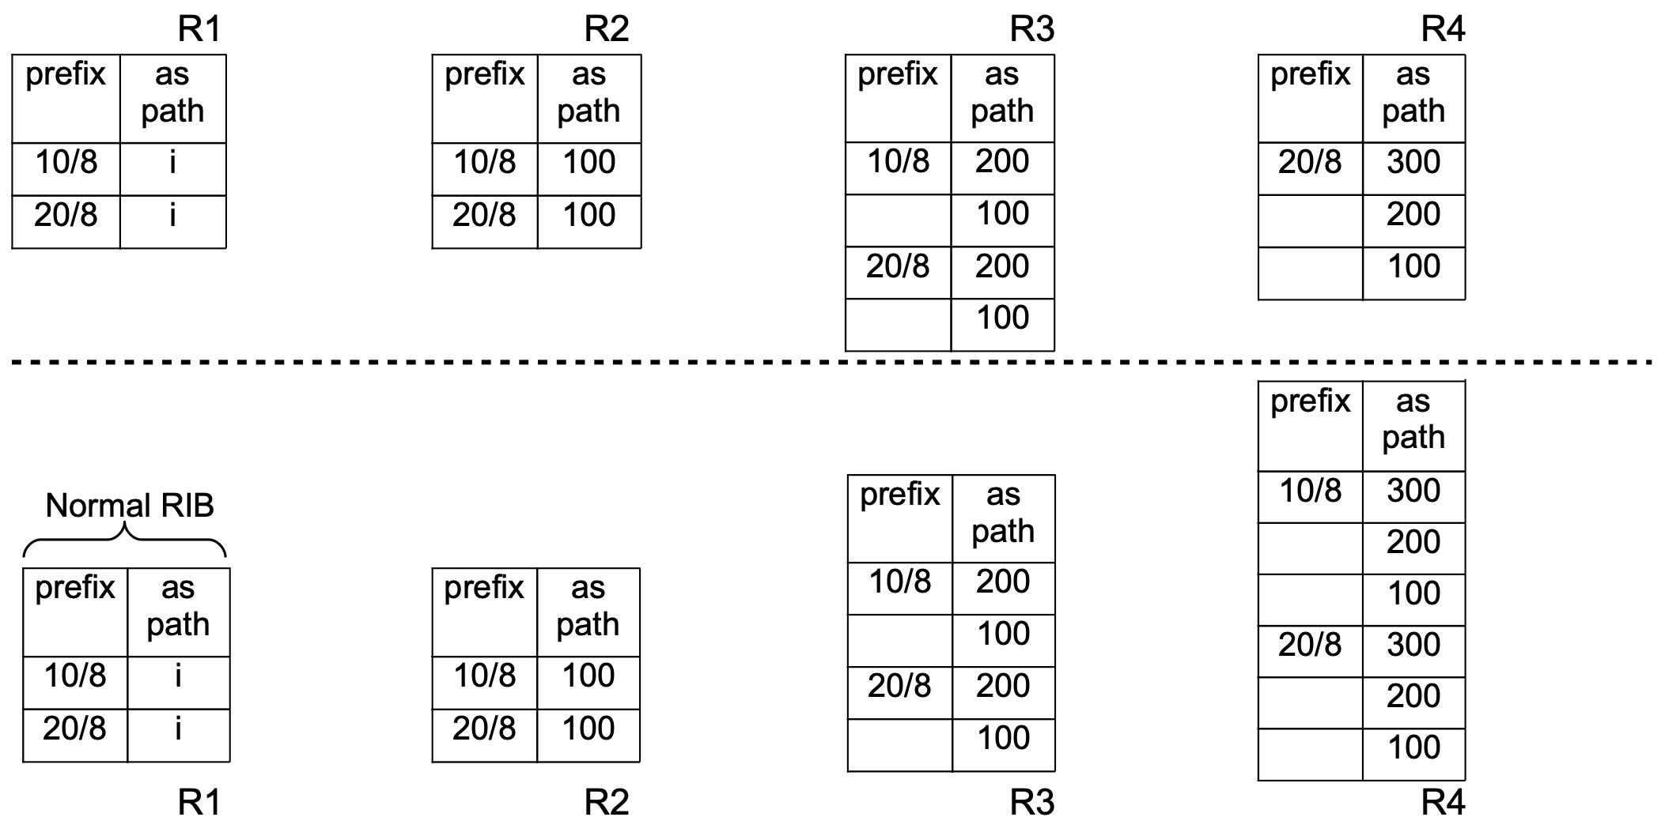
How to address the model faithfulness challenge?
Key insight:
Using production network RIBs as a reference to debug simulated model
Strawman solution:
Localizing vendor-specific behaviors by comparing real and simulated RIBs
Real-world routing tables
Diff
Same
Same
Same
Simulated routing tables
Notes:
A straw man solution is once a difference between real and simulated routing tables is detected, say R4’s routing table, the model tuner back traces the path until a router whose routing table is the same say R3 in this example.

Slide 57

How to address the model faithfulness challenge?
Key insight:
Using production network RIBs as a reference to debug simulated model
Strawman solution:
Localizing vendor-specific behaviors by comparing real and simulated RIBs
Real-world routing tables
Diff
Same
Same
Same
Simulated routing tables
Notes:
The vendor specific behavior should be in R3’s egress policy or R4’s ingress policy

Slide 58
How to address the model faithfulness challenge?
Key insight:
Using production network RIBs as a reference to debug simulated model
Strawman solution:
Localizing vendor-specific behaviors by comparing real and simulated RIBs
Real-world routing tables
However, using normal RIBs cannot localize the correct VSBs!
Diff
Same
Same
Same
Simulated routing tables
Notes:
Unfortunately, using normal RIBs cannot localize the correct VSBs in practice, since normal RIBs lack of a lot of useful information for the reference.

Slide 59
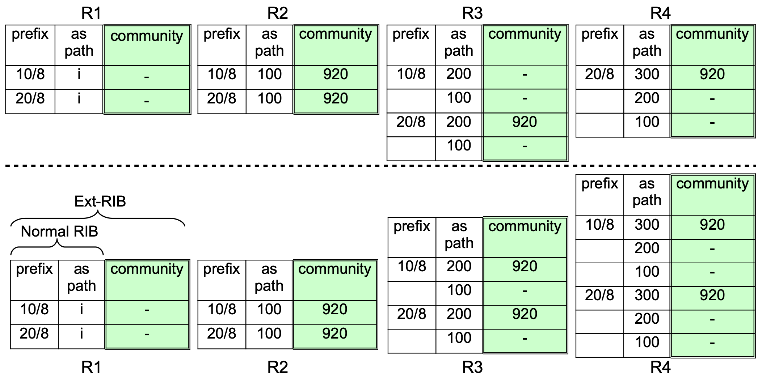
How to address the model faithfulness challenge?
Key insight:
Using production network RIBs as a reference to debug simulated model
Our solution:
Hoyan combines all the attributes of a route relevant for routing into an extended RIB
The first mismatch between real and simulated ext-RIBs is vendor-specific behavior
Real-world routing tables
Simulated routing tables
Notes:
Therefore our tuner uses extended RIBs rather than normal RIBs.

Slide 60
How to address the model faithfulness challenge?
Key insight:
Using production network RIBs as a reference to debug simulated model
Our solution:
Hoyan combines all the attributes of a route relevant for routing into an extended RIB
The first mismatch between real and simulated ext-RIBs is vendor-specific behavior
Real-world routing tables
Same
Same
Diff
Diff
Simulated routing tables
Notes:
After we introduce extended RIBs, we can observe that the tuner can correctly detect R3’s extended routing tables between real and simulation are different, so this VSB is existed in R2’s egress or R3’s ingress.

Slide 61
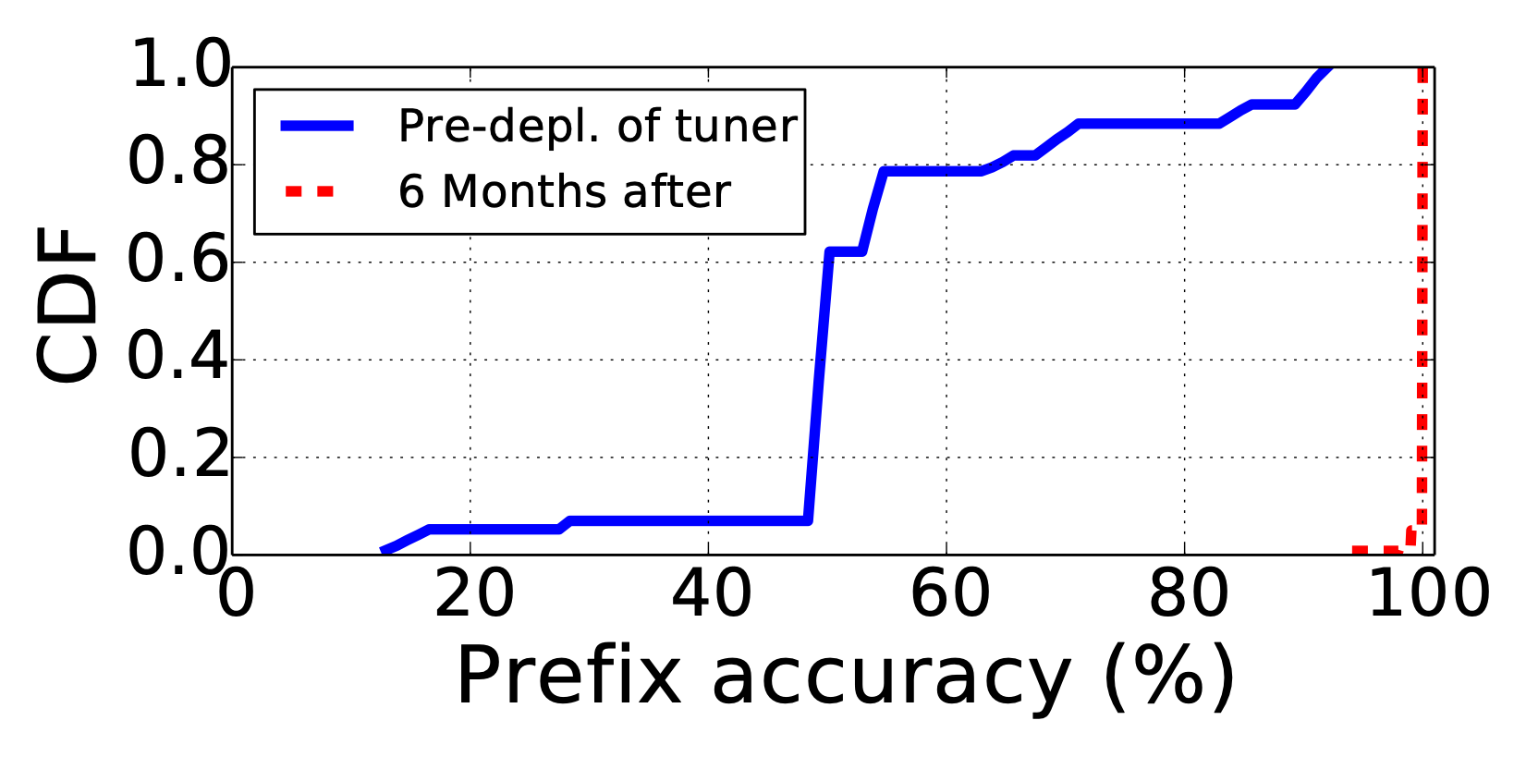
Device behavior model tuner
Eight VSBs detected
Default ACL, route policy, removing private AS, etc.;
VSB localization within 10 lines of configuration
Notes:
Our model tuner successfully detected eight VSBs by far, including default ACL, route policy, removing private AS, and so on. These VSBs significantly affected the accuracy of Hoyan’s verification results at the early stage of Hoyan usage. As shown in this picture, before we detected these VSBs, the accuracy of our verification is below 50%, but after used our model tuner six months, the accuracy of Hoyan has been near 100.

Slide 62
Hoyan: Deployment experience
The overall rate of update-triggered network incidents was cut by more than half in the second year of Hoyan’s deployment.
Notes:
Hoyan has been used in Alibaba’s global WAN for about two years. The overall rate of update-triggered network incidents was cut by more than half in the second year of Hoyan’s deployment.

Slide 63
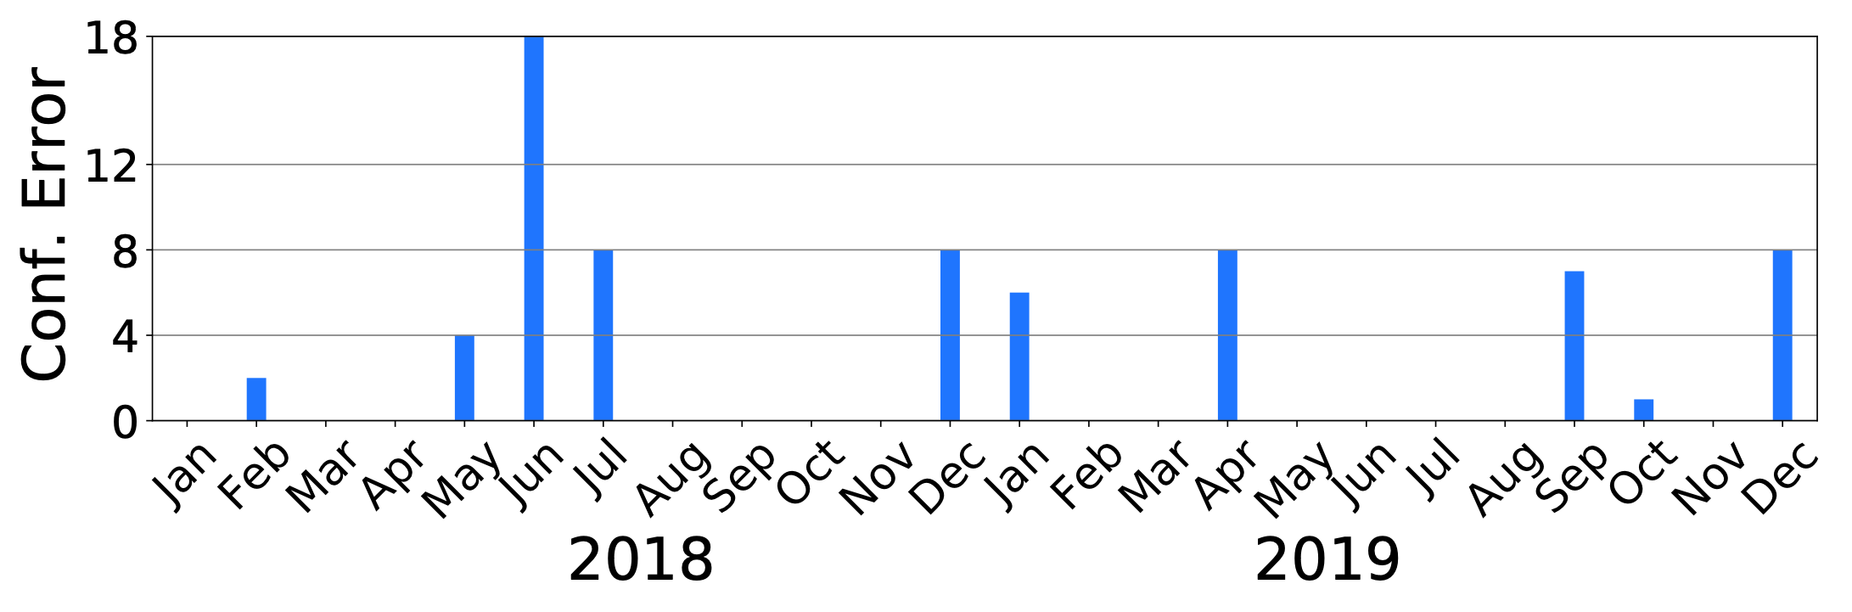
Hoyan: Deployment experience
The overall rate of update-triggered network incidents was cut by more than half in the second year of Hoyan’s deployment.
Configuration auditing verification (Jan 2018 - Dec 2019)
Notes:
During the two years, it detected many potential configuration errors hidden in our network such as IP address conflicts, and redundant device misconfiguration.

Slide 64
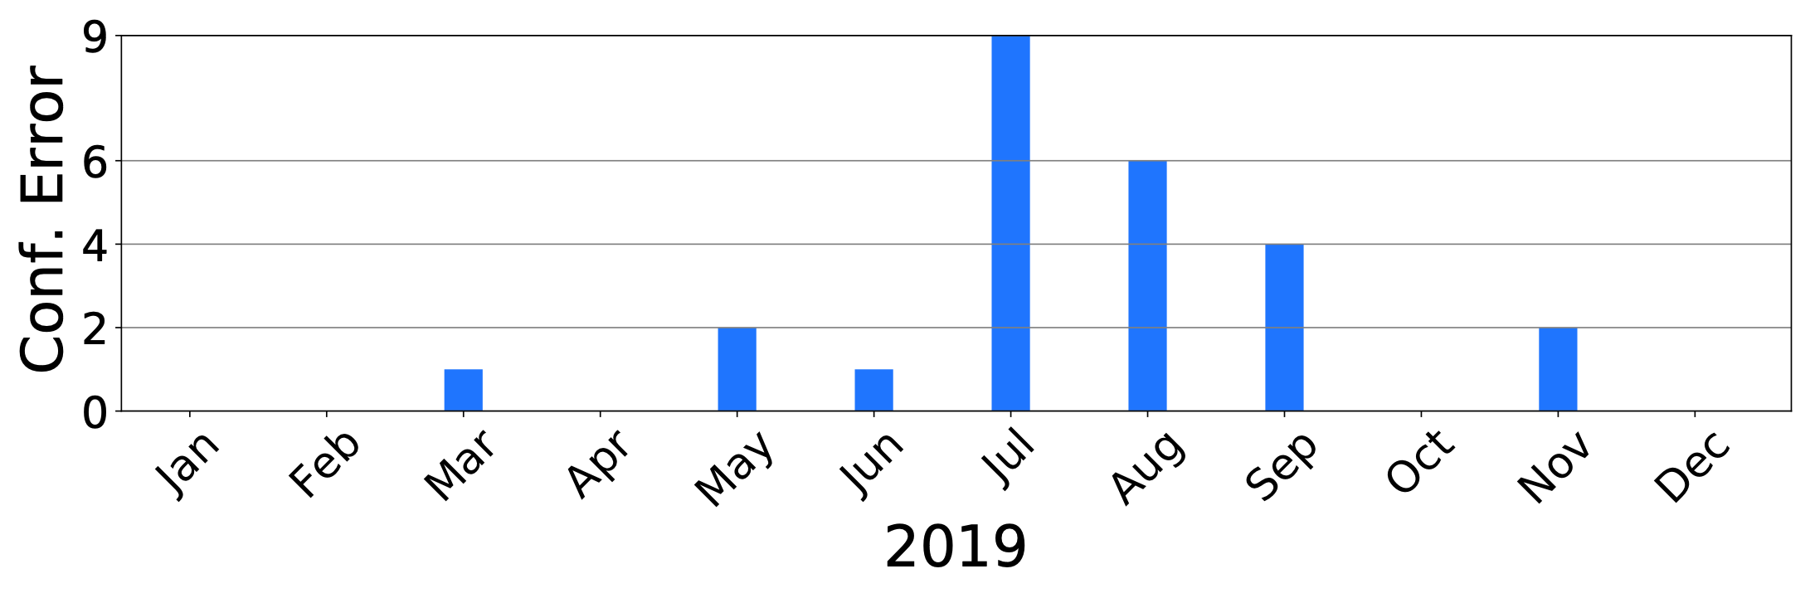
Hoyan: Deployment experience
The overall rate of update-triggered network incidents was cut by more than half in the second year of Hoyan’s deployment.
Configuration auditing verification (Jan 2018 - Dec 2019)
Configuration update verification (Jan 2019 - Dec 2019)
Notes:
Hoyan is also used to check our configuration update plans before they are committed to the network. In 2019, Hoyan detected many potential configuration errors in our update plans, significantly preventing AliCloud outages

Slide 65
Hoyan’s verification capability summary
What protocols are covered by Hoyan?
BGP (eBGP and iBGP), IGP (IS-IS and OSPF), static routes, route redistribution and ACL

Slide 66
Hoyan’s verification capability summary
What protocols are covered by Hoyan?
BGP (eBGP and iBGP), IGP (IS-IS and OSPF), static routes, route redistribution and ACL
What properties can Hoyan verify?
Reachability (route and packet reachability)
K-failure tolerance
Non-deterministic routing update race
Multipath consistency (equality)

Slide 67
01
复杂的云网络基础设施规划
02
基于 IBN 思想的网络规划
目录
03
具体例子：网络验证
04
更多的方向和未来的思考

Slide 68
Our lessons and open questions
Verification on WAN is more needed than DCNs
WAN is more complex than DCNs in routing policies and dependencies
WAN is not symmetric and configuration is not such “modular”
Tricky errors, e.g., non-deterministic issues

Slide 69
Our lessons and open questions
Verification on WAN is more needed than DCNs
WAN is more complex than DCNs in routing policies and dependencies
WAN is not symmetric and configuration is not such “modular”
Tricky errors, e.g., non-deterministic issues
Expressing intent and intent extraction
Multiple security domains and implicit business needs
Does example-based specification help? e.g., example spec verification or synthesis

Slide 70
Our lessons and open questions
Misconfiguration repairing
There are multiple ways to repair a misconfiguration. Which one is the best?
How to avoid side effects, i.e., new problems after fixing the target bug?
How to express the fixing purpose?

Slide 71
Our lessons and open questions
Misconfiguration repairing
There are multiple ways to repair a misconfiguration. Which one is the best?
How to avoid side effects, i.e., new problems after fixing the target bug?
How to express the fixing purpose?
Vendor diversity
Vendor diversity can prevent cascading failures
How to quantify diversity? How to detect my network diversity is low?
Can we transform a “non-diverse” network to a diverse network?

Slide 72

集中式网络规划体系
设计
交付
变更
运维
程序怎么写？
（语言设计）
属性描述
（语言设计）
运维描述程序/脚本
配置的生成
（synthesis）
变更生成
（synthesis）
核心算法（例如，验证或生成算法）
网络模型（网络行为抽象）
配置解析（屏蔽厂商细节）
不同厂商的设备
Notes:
To prevent the incidents resulting from network misconfiguration, Alibaba decided to adopt network verification to prevent configuration-induced incidents ahead of time. Our verification system is named Hoyan Jinjing. This name is from the skill of the monkey king in ancient Chinese myths, which means the monkey king can see the truth through his fire and golden eye. In SIGCOMM last year, we have presented our ACL verification work, Jinjing. Today I am going to talk about Hoyan, the routing configuration verification system.

Slide 73


THANKS

